Slide 1

Website Phishing DETECTION
- By Neha Pandit

Slide 2
Introduction to Website Phishing & Objective of Model
A link is not always what it seems. Hackers have gone to great lengths to create convincing websites that look just like the real deal. Oftentimes, this is spoofing a major company such as Microsoft. By convincingly spoofing legitimate websites, bad actors are hoping to encourage end-users to enter their credentials. Thus, URL phishing is a pretext for credential harvesting attacks.
When done properly, URL phishing can lead to usernames, passwords, credit cards, and other personal information being stolen. The most successful ones often require users to login into an email or bank account. Without proper defenses, end-users and companies could easily fall prey.
The objective of the model is to detect the legitimate websites as well as the phishing websites based on the important features.

Slide 3
Important Features of the model (On the basis of Random Forest)
Length of URL(length_url)
Length of hostname(length_hostname)
Number of www present in URL (nb_www)
Ratio of digits in full URL (ratio_digits_url)
Ratio of digits in hostname(ratio_digits_host)
Number of words(length_words_raw)
Repeated characters(char_repeat)
Shortest words in the hostname (shortest_word_host)
Longest words in the url(longest_words_raw)
longest words in the path(longest_word_path)
Total occurrence of the ff phish hints: ‘wp’, ‘login’, ‘includes’, ‘admin’, ‘content’, ‘site’, ‘images’, ‘js’, ‘alibaba’, ‘css’, ‘myaccount’, ‘dropbox’, ‘themes’, ‘plugins’, ‘signin’, ‘view’”(phish_hints)
Number of hyperlinks(nb_hyperlinks)
Ratio of internal hyperlinks(ratio_intHyperlinks)
Ratio of external hyperlinks(ratio_extHyperlinks)
Ratio of internal links in tags(links_in_tags)
Ratio of external redirections (ratio_extRedirection)
Presence of ‘#’, ‘javascript’, or ‘mailto’ tags(safe_anchor)
Age of URL domains(domain_age)
Length of domain renewals(domain_registration_length)
Number of visitors(web_traffic)
Whether website was indexed by Google(google_index)
Google Page Rank value, from Openpagerank(page_rank)

Slide 4
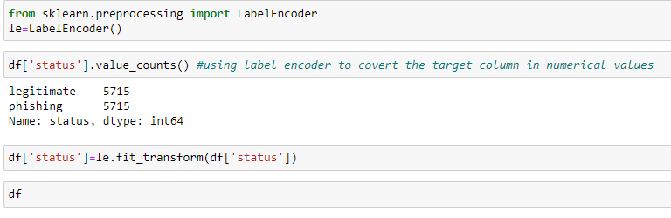
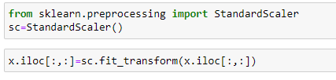


Preprocessing techniques used in Model
Encoding
Label encoder is used to convert the categorical values of the target column (Status) into numerical values.
Scaling
Standard Scaler removes the mean and scales each feature/variable to unit variance. This operation is performed feature-wise in an independent way.

Slide 5
Algorithms Used in the Model

Slide 6
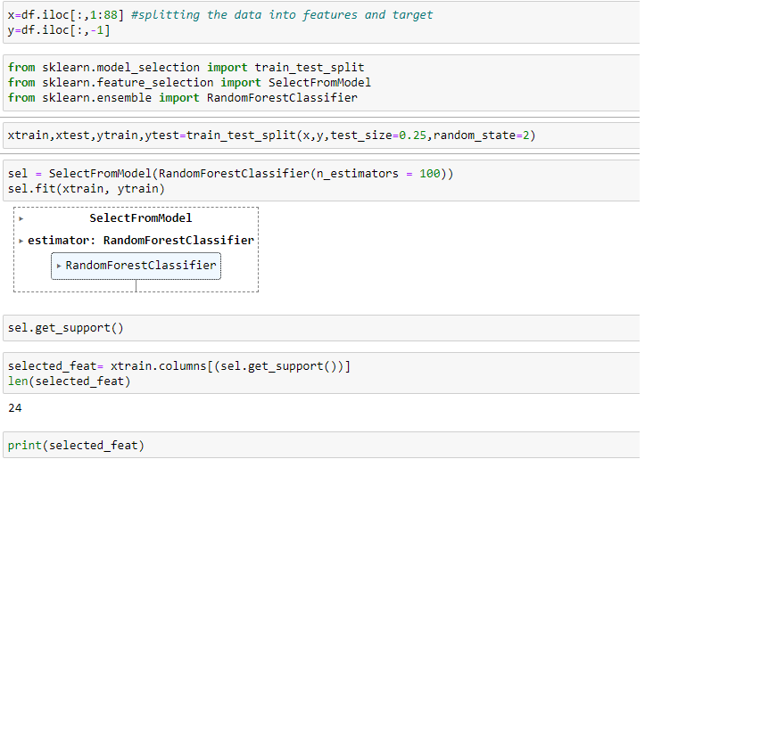


Random Forest used to select the important features of the Model
In random forests, the impurity decrease from each feature can be averaged across trees to determine the final importance of the variable.
For classification, the measure of impurity is either the Gini impurity or the information gain/entropy.

Slide 7
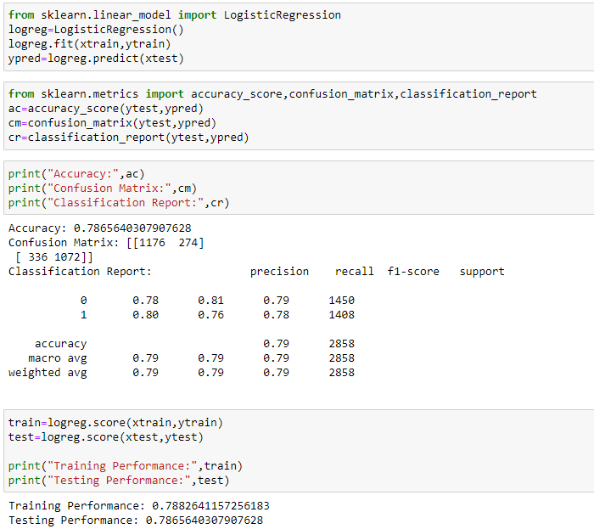

Logistic Regression
Logistic regression is a process of modeling the probability of a discrete outcome given an input variable. The most common logistic regression models a binary outcome; something that can take two values such as true/false, yes/no, and so on.

Slide 8
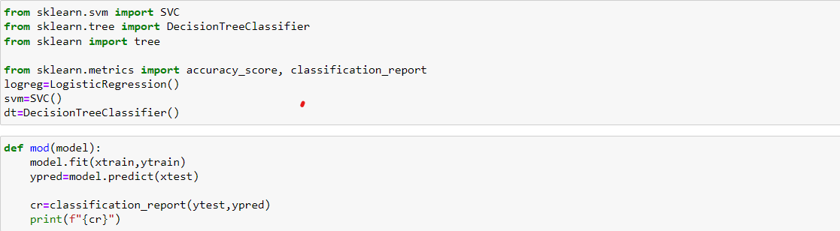
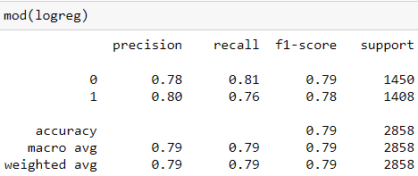
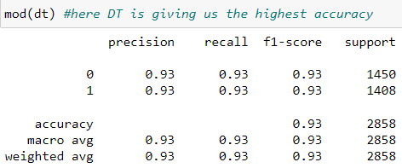
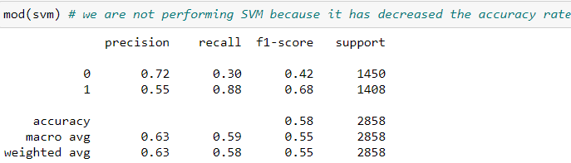





Checking the accuracy using Logistic Regression, SVC and Decision Tree Classifier
Decision Tree Classifier is giving the highest accuracy rate of 93.00%

Slide 9
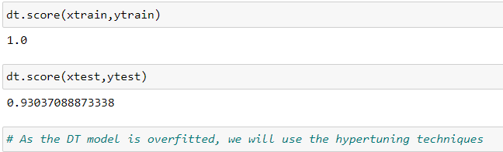


Decision Tree
Decision Tree is a Supervised Machine Learning Algorithm that uses a set of rules to make decisions, similarly to how humans make decisions.
One way to think of a Machine Learning classification algorithm is that it is built to make decisions.
Is your Decision Tree Overfitting?
Overfitting refers to the condition when the model completely fits the training data but fails to generalize the testing unseen data. Overfit condition arises when the model memorizes the noise of the training data and fails to capture important patterns. A perfectly fit decision tree performs well for training data but performs poorly for unseen test data.

Slide 10
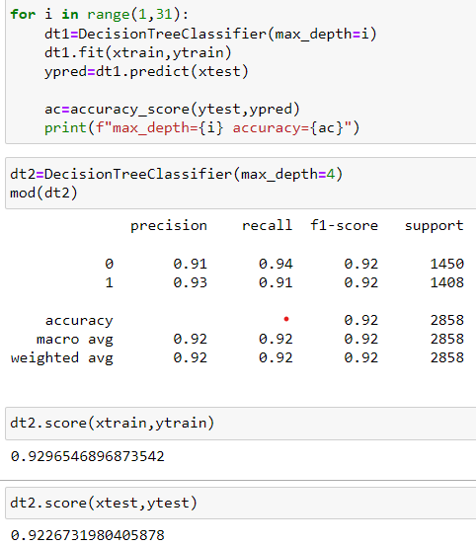
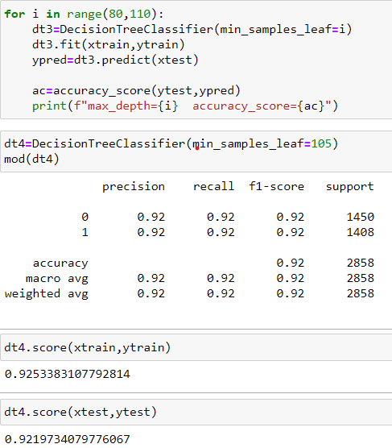
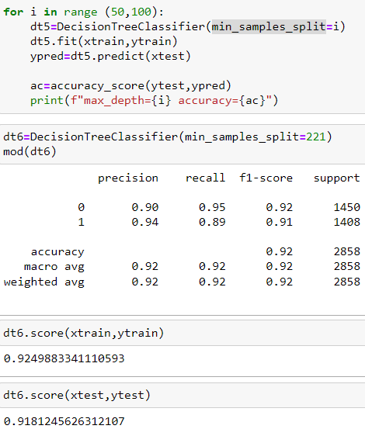






Pruning Techniques used to overcome the problem of overfitting.
Max_depth
Min_samples_leaf
Min_samples_split
92% accuracy at max_depth=4
92% accuracy with min_samples_leaf=105
92% accuracy with min_samples_split=221

Slide 11
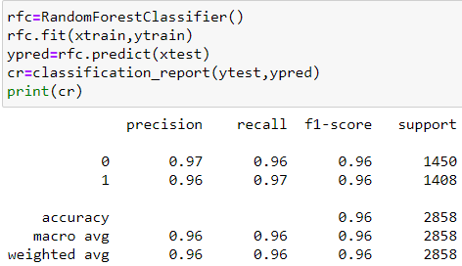



Random Forest Classifier
Random Forest is a popular machine learning algorithm used for classification and regression tasks due to its high accuracy, robustness, feature importance, versatility, and scalability.

Slide 12
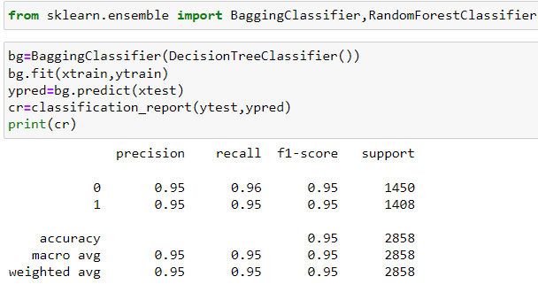
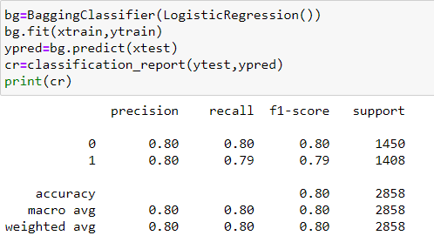




Bagging
Bagging, also known as bootstrap aggregation, is the ensemble learning method that is commonly used to reduce variance within a noisy dataset. In bagging, a random sample of data in a training set is selected with replacement—meaning that the individual data points can be chosen more than once.

Slide 13
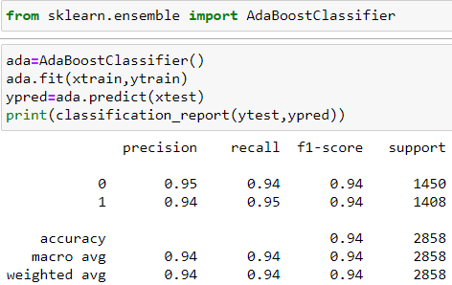
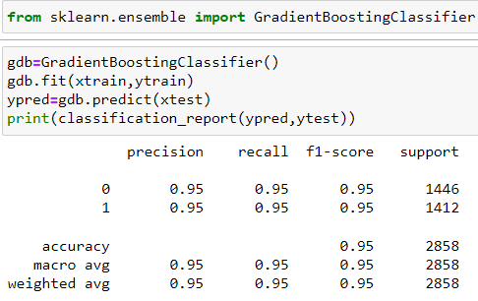
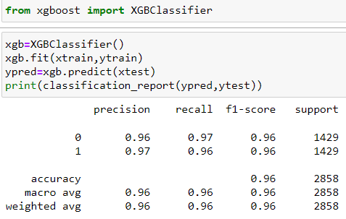





Boosting
Boosting is a powerful technique in machine learning that aims to improve the predictive accuracy of models by combining multiple weak learners.
There are three types of boosting which are Adaptive boosting, Gradient boosting and Extreme gradient boosting

Slide 14
Conclusion
The highest accuracy rate is achieved using the Extreme gradient boosting and Random Forest Classifier (96.00%)
The second highest accuracy rate is achieved using the Voting Classifier and Bagging Classifier (95.00%)
The least accuracy rate is achieved using the SVC (58.00%)

Slide 15
Thankyou!

